Slide 1
Term project Proposal
VERSION 1

Slide 2
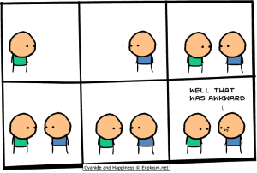
Motivation
Think about it …
It is not easy for some people to interactive with another people actively.
Feelings at the moment might be forgotten.
What should I say?
Ummm….
Notes:
互動性不足：
紀念性（實體）
關係連結的延續效果不足

Slide 3
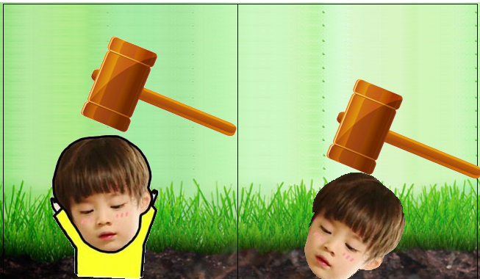


Content
Become more familiar with each other via more interaction.
Little Competition
We want to …
Oh~No~
Yeah~
Notes:
時間限制內製作明信片
投幣後，自己編輯的明信片和留的話，會送給對方

Slide 4

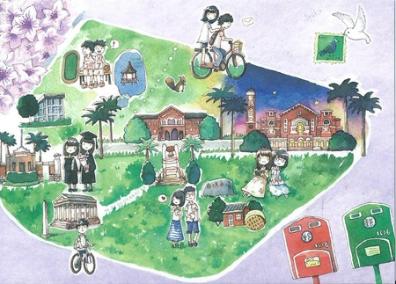

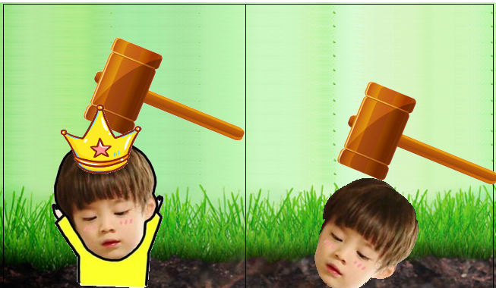


Content
Let users make unique souvenirs for their new friends.
Write down memories belong together
Notes:
時間限制內製作明信片
投幣後，自己編輯的明信片和留的話，會送給對方

Slide 5
Term project Proposal
VERSION 2

Slide 6
Motivation
Think about it …
It is not easy for some people to interactive with another people actively.
Quartic Smile may not have enough attraction to some people.
What should I say?
Ummm….

Slide 7

We want to…
Content
use Hologram Projector to be more attractive

Slide 8
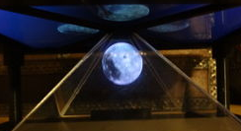
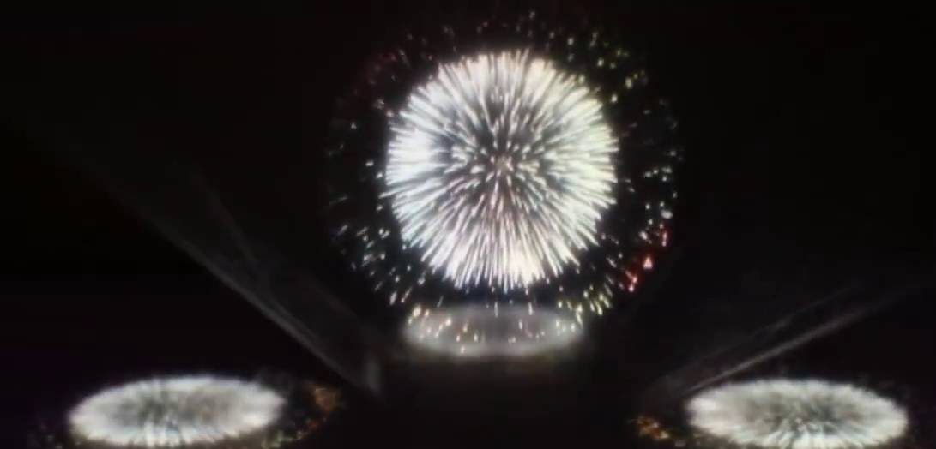
Content
When there is no user, the Quartic Smile will show the earth. At this time, the hologram will display the earth and the VFX alternatively.
Quartic Smile
Hologram
earth
Earth
VFX

Slide 9
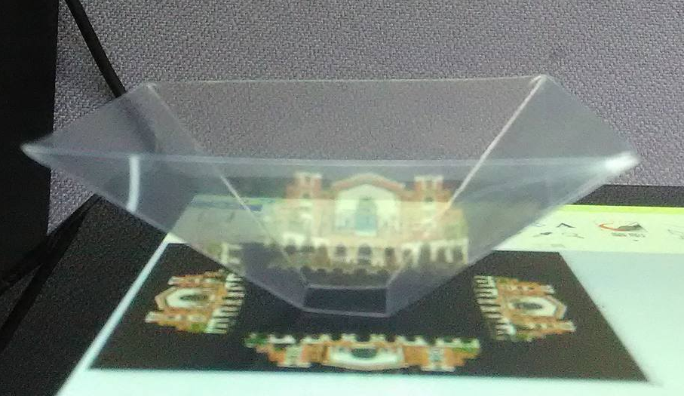
Content
When the view shows landing, the hologram will display the corner of campus.
Quartic Smile
Hologram
NTU library
Corner of Campus
(NTU library)

Slide 10
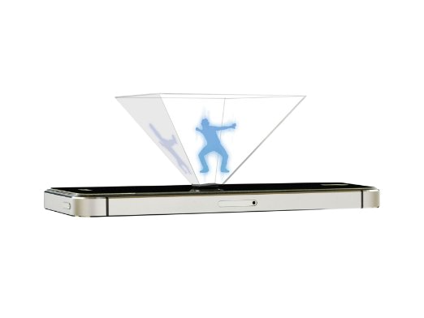
Content
When the wormhole is opened, the hologram will display myself and the AR objects the opposite person add for you simultaneously.
Quartic Smile
Hologram
Wormhole

